Slide 1
Theoretical Distribution

Slide 2
Binominal distribution(Bernoulli)
Binominal appropriation is a discrete likelihood conveyance. This distribution was discovered by a Swiss Mathematician James Bernoulli. It is used in such situation where an experiment results in two possibilities - success and failure. Binomial distribution is a discrete probability distribution which expresses the probability of one set of two alternatives-successes (p) and failure (q). Binomial distribution is defined and given by the following probability function −
Probability Mass Function –
P(X-x) = ^{n}C_{x}.p^{x} Q^{n−x}

Slide 3
p = Probability of success.
q = Probability of failure = 1−p.
n = Number of trials.
P(X−x) = Probability of x successes in n trials.

Slide 4
A binomial distribution can be understood as the probability of a trail with two and only two outcomes. It is a type of distribution that has two different outcomes namely, ‘success’ and ‘failure’ (a typical Bernoulli trial). It is applicable to discrete random variables only.

Slide 5
Binomial Distribution Criteria
The binomial distribution is a common way to test the distribution and it is frequently used in statistics. There are two most important variables in the binomial formula such as:
‘n’ it stands for the number of times the experiment is conducted
‘p’ represents the possibility of one specific outcome
We can write formula:
b(x,n,p)= nCx P^{x} (1-P)^{n-x} for x=0,1,2,…..n.

Slide 6
Mean and Variance of a Binomial Distribution
Mean(µ) = np Variance(σ²) = npq

Slide 7
Problem Statement −
Eight coins are tossed at the same time. Discover the likelihood of getting no less than 6 heads.
Let
p=probability of getting a head. q=probability of getting a tail.

Slide 8
Here, p=1/2, q=1/2, n=8,
P(X−x) = ^{n}C_{x Q}^{n−x px}
P(at least 6 heads)= P(6H)+P(7H)+P(8H),
^{8C}_{6(1/2)}^{2(1/2)6+ 8C}_{7(1/2)}^{1(1/2)7+ 8C}_{8(1/2)}⁸
^{=28×1256+8×1256+1×1256}
⁼³⁷²⁵⁶

Slide 9
Practice problem
a) 8 coins are tossed at a time, 256 times. Find the expected frequencies of successes (getting a head) and tabulate the result obtained.
b) also obtained the values of the mean and standard deviation of the fitted distribution.

Slide 10
Sol:
In the usual notations, we are given: n=8 and N=256
P= probability of success (head)in a single throw of a coin=1/2
Q=1-p=1/2
Hence by the binomial probability law, the probability of r successes in a toss of 8 coins is given by:
p(r)= nCx P^{x} (1-P)^{n-x}
= 8Cx (½)^{x} (1/2)^{8-x}
= 8Cx (½)^{8 ________(1)}
Hence, in N=256 throw of 8 coins, the frequency of r successes is:

Slide 11
F( r) = N. p( r)
=256. 1/256 8Cx
= 8Cx where r=0,1,2,3,....8
Thus the expected frequency are as obtained:
No.of heads | 0 | 1 | 2 | 3 | 4 | 5 | 6 | 7 | 8
Expected Frequencies | 8C0= 1 | 8C1=8 | 8C2=28 | 8C3=56 | 8C4=70 | 8C5=56 | 8C6=28 | 8C7=8 | 8C8=1

Slide 12

II) for the theoretical distribution
Mean=np=8*1/2=4
Standard deviation= $\sqrt{npq }=\sqrt{8∗\frac{1}{2}∗1/2 }=\sqrt{2}$= 1.4142

Slide 13
Practice problem
Fit a binomial distribution to the following data:
X | 0 | 1 | 2 | 3 | 4
F | 28 | 62 | 46 | 10 | 4

Slide 14
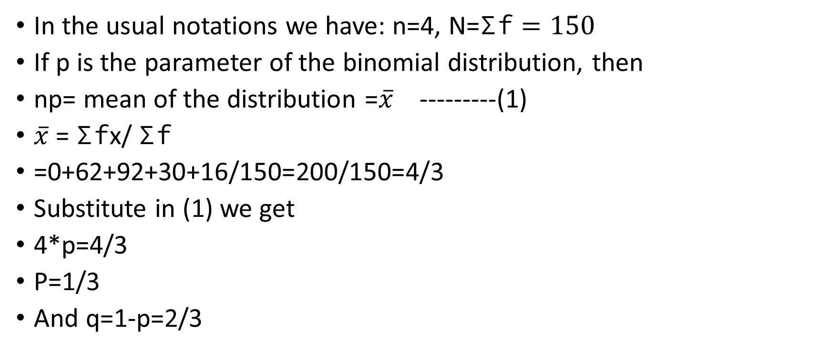
Solution:
In the usual notations we have: n=4, N=$\text{Σ}\text{f}=150$
If p is the parameter of the binomial distribution, then
np= mean of the distribution =$\overline{x}$ ---------(1)
$\overline{x}$ = $\text{Σ}\text{f}$x/ $\text{Σ}\text{f}$
=0+62+92+30+16/150=200/150=4/3
Substitute in (1) we get
4*p=4/3
P=1/3
And q=1-p=2/3

Slide 15
The expected binomial probabilities are given by:
p(x)= nCx P^{x} (1-P)^{n-x}
=4Cx (1/3)^{x} (2/3)^{4-x} ______(2)
Putting x=0,1,2,3 and 4 in (2), we get the expected binomial probabilities as given in the table

Slide 16
X | P(x) | F(x) =N.p(x) = 150.p(x)
0 | 4C0 (1/3)⁰ (2/3)⁴ =16/81 | 150 . .1975=29.63=30
1 |  | 59
2 |  | 44
3 |  | 15
4 |  | 2

Slide 17
Hence the fitted binomial distribution is:
X | 0 | 1 | 2 | 3 | 4 | total
f | 30 | 59 | 44 | 15 | 2 | 150

Slide 18
Practice problem
Six dice are thrown 729 times. How many times do you expect at least three dice to show a five or six?
sol: here we are given n=6 and N=729
Let the event of getting 5 or 6 in the throw of a single die be called a success. Then p=probability of success =1/6+1/6=1/3
Q=1-p=1-1/3=2/3
In a single throw of 6 dice, the probability of getting r success is given by the binomial law:
P(r)= nCx P^{x} (1-P)^{n-x}

Slide 19
p(x)= 6Cr (1/3)^{r} (2/3)^{6-r}
=1/729 6Cr(2)^{6-r}
Thus the probability that at least three dice show 5 or 6 is
P(3)+p(4)+p(5)+p(6)
Hence in 729 throw of 6 dice each, the required frequency of getting at least 3 successed is
N [P(3)+p(4)+p(5)+p(6)]
=729*1/729[⁶C₃ * 2³ +⁶C₄ * 2² +⁶C₅ * 2+⁶C₆ * 2⁰ ]
⁼²³³

Slide 20
Poisson distribution
The Poisson distribution is a discrete probability function that means the variable can only take specific values in a given list of numbers, probably infinite. A Poisson distribution measures how many times an event is likely to occur within “x” period of time. In other words, we can define it as the probability distribution that results from the Poisson experiment. A Poisson experiment is a statistical experiment that classifies the experiment into two categories, such as success or failure. Poisson distribution is a limiting process of the binomial distribution.
A Poisson random variable “x” defines the number of successes in the experiment. This distribution occurs when there are events that do not occur as the outcomes of a definite number of outcomes. Poisson distribution is used under certain conditions. They are:
The number of trials “n” tends to infinity
Probability of success “p” tends to zero
np = 1 is finite

Slide 21
The formula for the Poisson distribution function is given by:
f(x) =(e^{– λ} λ^{x})/x!
Where,
e is the base of the logarithm
x is a Poisson random variable
λ is an average rate of value
For the poisson distribution with the parameter m or λ, we have Mean=variance=λ=m

Slide 22
Example:
If 5% of the electric bulbs manufactured by a company are defective, use Poisson distribution to find the probability that in a sample of 100 bulbs:
1) none is defective
2) 5 bulbs will be defective. (given e^{– 5 =.007)}
sol: here we are given:
P=probability of a defective bulbs=5%=.05
Since p is small and n is large, we may approximate the given distribution by Poisson distribution. Hence, the parameter m of the Poisson distribution is:

Slide 23
M=np=100*.05=5
Let the random variable X denote the number of defective bulbs in a sample of 100. then (by poisson probability law)
P(x) =(e^{– m} m^{x})/x!
P(x) =(e^{– 5} 5^{x})/x! X=0,1,2…….
1) the probability that none of the bulb is defective is given by:
P(X=0)=e^{– 5} =.007
2) the probability that 5 bulbs are defective

Slide 24
P(x) =(e^{– 5} 5^{x})/x!
=.007*625/24
.1823

Slide 25
Example:
Consider a computer system with Poisson job-arrival stream at an average of 2 per minute. Determine the probability that in any one-minute interval there will be
(i) 0 jobs;
(ii) exactly 2 jobs;
(iii) at most 3 arrivals.

Slide 26
Solution:
Job Arrivals with λ = 2
(i) No job arrivals: P(X = 0) = e −2 = .135
(ii) Exactly 3 job arrivals: P(X = 3) = (e^{– 2} 2³)/3!
= .18
(iii) At most 3 arrivals P(X ≤ 3) = P(0) + P(1) + P(2) + P(3) =
=e −2 + (e^{– 2} 2)/1!+ (e^{– 2} 2²)/2!+ (e– 2³)/3!
= 0.1353 + 0.2707 + 0.2707 + 0.1805 = 0.8571

Slide 27
The number of industrial injuries per working week in a particular factory is known to follow a Poisson distribution with mean 0.5. Find the probability that
(a) in a particular week there will be:
(i) less than 2 accidents,
(ii) more than 2 accidents;
(b) in a three week period there will be no accidents.

Slide 28
Sol:
Let A be 'the number of accidents in one week’,
so A ~ P0 (0.5).
(a)
(i) P (A< 2) = P (A ≤ 1) = 0.9098
from the formula, P (A < 2) = P (A = 0) + P (A = 1)
= e −0.5 + e −0.5 × 0.5/ 1!
=0.9098.

Slide 29
(ii) P A( > 2) = 1− P (A≤ 2)
= 1 − 0.9856
=0.0144
(b) P (0 in 3 weeks) = (e^{− 0.5})³
≈ 0.223.

Slide 30
Normal Distribution
A normal distribution is an arrangement of a data set in which most values cluster in the middle of the range and the rest taper off symmetrically toward either extreme. Height is one simple example of something that follows a normal distribution pattern: Most people are of average height the numbers of people that are taller and shorter than average are fairly equal and a very small (and still roughly equivalent) number of people are either extremely tall or extremely short.Here's an example of a normal distribution curve:

Slide 31

= $\frac{1}{2π}e^{−(x−μ)2/2σ}$
Where −
μ = Mean
σ = Standard Deviation
π≈3.14159
e≈2.71828

Slide 32
Problem Statement:
A survey of daily travel time had these results (in minutes):
26 33 65 28 34 55 25 44 50 36 26 37 43 62 35 38 45 32 28 34
The Mean is 38.8 minutes, and the Standard Deviation is 11.4 minutes. Convert the values to z - scores and prepare the Normal Distribution Graph.

Slide 33
Solution:
The formula for z-score that we have been using:
z=x−μ/σ
Where −
z = the "z-score" (Standard Score)
x = the value to be standardized
μ = mean
σ = the standard deviation

Slide 34
To convert 26:
First subtract the mean: 26-38.8 = -12.8,
Then divide by the Standard Deviation: -12.8/11.4 = -1.12
So 26 is -1.12 Standard Deviation from the Mean

Slide 35
Original Value Calculation Standard Score (z-score)
26 (26-38.8) / 11.4 = -1.12
33 (33-38.8) / 11.4 = -0.51
65 (65-38.8) / 11.4 = -2.30

Slide 36
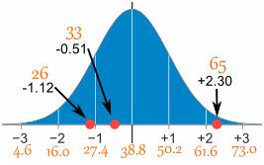

Slide 37
What is the difference between the Poisson distribution and normal distribution?
The major difference between the Poisson distribution and the normal distribution is that the Poisson distribution is discrete whereas the normal distribution is continuous. If the mean of the Poisson distribution becomes larger, then the Poisson distribution is similar to the normal distribution.

Slide 38
Characteristic | Normal | Poisson
Continuous or discrete | Continuous | Discrete
Parameter | Mean (µ) and standard deviation (σ) | Lambda (λ)
Shape | Bell-shaped | Depends on λ
Symmetry | Symmetrical | Asymmetrical (right-skewed). As λ increases, the asymmetry decreases.
Range | −∞ to ∞ | 0 to ∞

